Slide 1
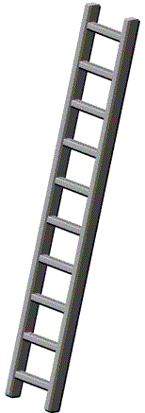
Think of this ladder as representing people's social status in the country you live in. At the top of the ladder are the people who are the best off -- those who have the most money, the most education, and the most respected jobs. At the bottom are the people who are the worst off -- who have the least money, the least education, and the least respected jobs or no job. Where would you place yourself on this ladder compared to people in the country you live in?
□
10
Top
□
9
□
8
□
7
□
6
□
5
Middle
□
4
□
3
□
2
□
1
□
0
Bottom

Slide 2
15.
□
13. Think of this ladder as representing people's social status in the country you live in. At the top of the ladder are the people who are the best off -- those who have the most money, the most education, and the most respected jobs. At the bottom are the people who are the worst off -- who have the least money, the least education, and the least respected jobs or no job. Where would you place yourself on this ladder compared to people in the country you live in?
10
Top
□
9
□
8
□
7
□
6
□
5
Middle
□
4
□
3
□
2
□
1
□
0
Bottom

Slide 3
想象这个梯子代表人们在社会所处的地位。
梯子的最上层是社会地位最好的人，他们的财富最多，所受教育最多，工作最好。 梯子的最下层是社会地位最糟糕的人，他们的财富最少，所受教育最少，工作最差。
请在梯子上选择你认为 自己 所处的位置。
□
10
上
□
9
□
8
□
7
□
6
□
5
中
□
4
□
3
□
2
□
1
□
0
下
SES Ladder Chinese - self

Slide 4
想象这个梯子代表人们在社会所处的地位。
梯子的最上层是社会地位最好的家庭，他们的财富最多，所受教育最多，工作最好。 梯子的最下层是社会地位最糟糕的家庭，他们的财富最少，所受教育最少，工作最差。
请在梯子上选择你认为自己的家庭所处的位置
□
10
上
□
9
□
8
□
7
□
6
□
5
中
□
4
□
3
□
2
□
1
□
0
下
SES Ladder Chinese - families

